Slide 1

Effective Strategies for Improving Supply Chain Operations Inventory Management
Dr. David Ben-Arieh

Slide 2

Why is it so hard to “optimize”
Static solutions verses dynamic
Deterministic approach verses Stochastic
Single level vs. multi level (multi echelon inventory systems)
Single product or multiple products
…
Notes:
Very complex environment with very few analytical approaches to solutions.

Slide 3
Demonstration: The Beer Game
Try to follow this “simple” example:
Notes:
We will spend about 3 minutes looking at the demo and the complexity of the game. Keep in mind that the strategies of other players are not known.

Slide 4
Very Basic Inventory Management
Static, deterministic, single level, single product.
EOQ or POQ models:
Inventory level
Inventory
Q
I_{max}
p-d
-d
Q/2
Q/D
2Q/D
3Q/D
4Q/D
t₁
t₂
Time
Time
Notes:
Simplest case – useful as a lower bound on cost, order size etc.

Slide 5
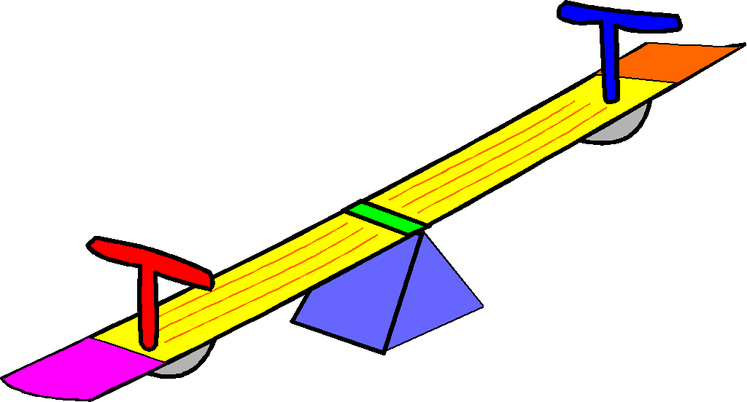
Very Basic Inventory Management
Static, deterministic, single level, single product.
Holding cost
Ordering cost
Notes:
Relatively simple balancing act.

Slide 6
Somewhat Basic Inventory Management
Static, deterministic, variable demand, single level, single product.
Example:
Solution: Not hard – Dynamic Programming.
Notes:
More intricate just by removing one constraint of the EOQ model.

Slide 7
Somewhat Basic Inventory Management
- Additional Issues
Quantity discount
Variable (uncertain) lead time
Cost of lead-time commitment
Cost of contract flexibility (order quantities).
Many more…

Slide 8
Basic Stochastic Model – still Static
Static, Single period but stochastic!
(Newspaper boy model)
Risk of Holding
Φ(Z)
Risk of shortage
0
z
Notes:
Now the change is that the demand is unknown (which is often the case)
Solution is based on expected minimum cost – so for repeated purchases it is OK.

Slide 9
Less basic Stochastic Model – still Static
Base Stock Model: No ordering costs
Multi period !
Order one item at a time
Demand is approximated by a distribution
Manageable but hard:
Concerns about cost and Service Level!
Notes:
This demonstrates the issue on hand – how many to have in stock!
Useful for our Supply Chain node.

Slide 10
Advanced Stochastic Model – still Static
Multi period
Service level or cost
Considers order quantity AND reorder point.
Generates “Safety Stock”
Risk of Holding
Risk of shortage
Notes:
Show the dynamics in the next slide

Slide 11
Advanced Stochastic Model – still Static
Multi period
Service level or cost
Considers order quantity AND reorder point.
Generates “Safety Stock”
Inventory
Q
r
l
Solvable but hard.
Produces a fixed strategy for many periods.

Slide 12
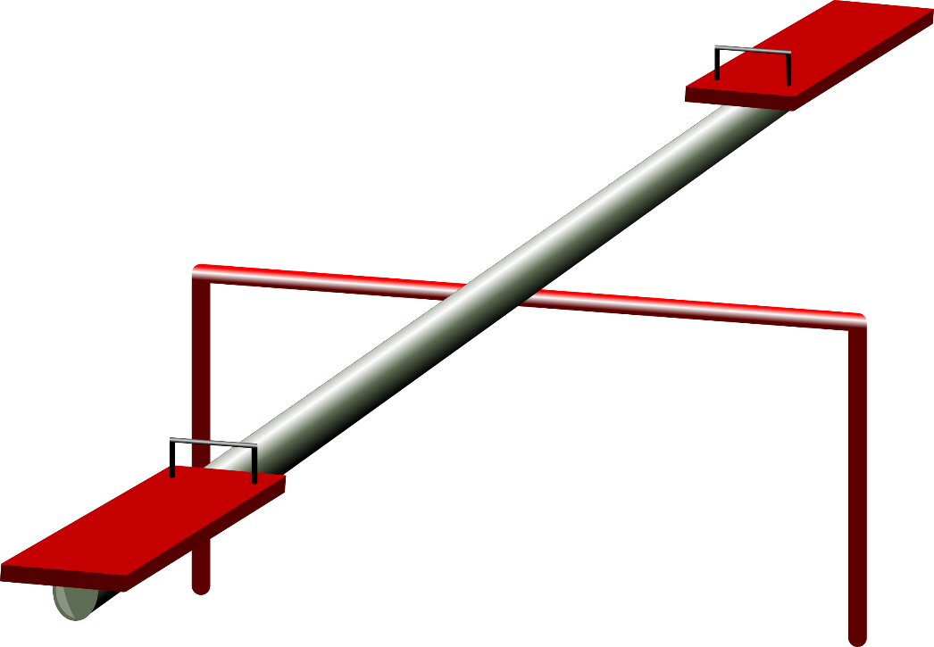
Advanced Stochastic Model – still Static
Cost of potential shortage
Cost of holding inventory
Service level
Cost of ordering
Notes:
This model (Q,R) is complex since it considers more issues – still one node and in a stationary mode (all periods are the same).

Slide 13
Dynamic Models –Multi Station Flow
“horizontal” or one –way flow
Based on rates of service
Consider Bottleneck Rate and “Raw processing time”
Notes:
A whole different approach.

Slide 14
Dynamic Models –Multi Station Flow
Provide envelop of performance (one supplier at a time)
.5
Throughput (Jobs/hr)
.4
Cycle time (Hours)
20
16
.3
12
.2
8
.1
4
0
0
0 2 4 6 8
0 2 4 6 8
WIP (Jobs)
WIP (Jobs)
Notes:
A whole different approach.

Slide 15
Dynamic Models –Impeding Factors
Individual Node
Natural variability
Unexpected delays (issues of reliability/quality)
Planned delays (setups, batching etc. - management)
Notes:
We can easily develop some boundaries of the system such as upper bound of Throughput (which is the Bottleneck rate) and Cycle Time.

Slide 16
Dynamic Models – Flow between Nodes
Flow Variability:
Arrivals variability
Departure variability
Utilization
c_{e}²(i)
c_{e}²(i+1)
c_{a}²(i)
c_{d}²(i) = c_{a}²(i+1)
i
i+1
r_{a}(i)
r_{d}(i) = r_{a}(i+1)
r_{e}(i)
r_{e}(i+1)
Notes:
Now we can connect independent nodes to an entire system of flow, queues, waiting times and inventory.

Slide 17
Illustrating Flow Variability
Low variability arrivals
t
smooth!
High variability arrivals
t
bursty!

Slide 18
Putting it all together
Considers individual variability of all types
Considers operational variability (Flow)
Combining each node to the next one
Allows quantitative modeling (no need for simulation)
Notes:
Here we can see how to put it all together using the queuing approach which is much simpler than a simulation model.

Slide 19

Putting it all together - Example

